Slide 1
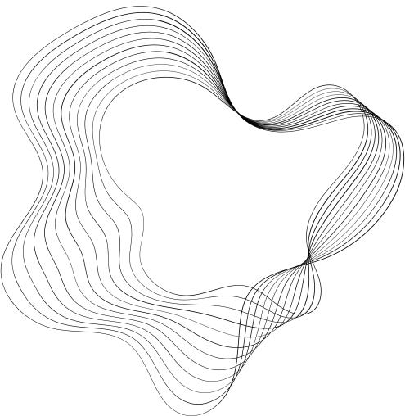

DETECTING LANE LINES WITH COMPUTER VISION: A PYTHON AND OPENCV APPROACH
PRESENTED BY:
VARUN D
2021503567
Madras Institute Of Technology
1A39BFD15A49F27965B4F30196A921B5
dvarun2003@gmail.com

Slide 2
PROBLEM STATEMENT
The problem at hand is the automatic detection of lane lines in images or video streams, a crucial component for the development of self-driving cars. We aim to create a robust algorithm using Python and OpenCV to accurately identify and delineate lane lines on roads under various conditions such as different lighting, road surface types, and weather.

Slide 3
PROPOSED SYSTEM/SOLUTION:
Our proposed system involves implementing a pipeline using various computer vision techniques such as color selection, region of interest selection, grayscaling, Gaussian smoothing, Canny Edge Detection, and Hough Transform line detection. By combining these techniques, we will develop a comprehensive solution to reliably detect and annotate lane lines in images and video streams

Slide 4
Algorithm & Deployment:
Color Selection: Identify the lane lines based on their color characteristics, typically white or yellow.
Region of Interest Selection: Define the region of interest where lane lines are expected to be located.
Grayscaling: Convert the selected region to grayscale to simplify subsequent processing steps.
Gaussian Smoothing: Apply Gaussian smoothing to reduce noise and enhance lane line detection.
Canny Edge Detection: Detect edges within the region of interest using the Canny edge detection algorithm.
Hough Transform Line Detection: Utilize the Hough Transform to identify lines within the edge-detected image, representing potential lane lines.
Line Averaging and Extrapolation: Average and extrapolate the detected line segments to obtain continuous lane lines.
Drawing: Overlay the detected lane lines onto the original image for visualization.

Slide 5
SYSTEM DEVELOPMENT APPROACH:
The algorithm will be implemented in Python using the OpenCV library. Once developed, the system will be deployed to process both images and video streams, enabling real-time lane line detection.

Slide 6
RESULT:
Upon implementation and testing, the system successfully detects and annotates lane lines in images and video streams. The accuracy and robustness of the algorithm are evaluated under various conditions, demonstrating its effectiveness in different scenarios.

Slide 7
CONCLUSION:
The proposed system provides a reliable solution for lane line detection using computer vision techniques. By accurately identifying and annotating lane lines, it lays the foundation for the development of advanced driver assistance systems (ADAS) and autonomous vehicles, contributing to improved road safety and traffic management.

Slide 8
REFERENCES:
OpenCV Documentation: https://opencv.org/
Python Documentation: https://docs.python.org/
Udacity Self-Driving Car Nanodegree: https://www.udacity.com/course/self-driving-car-engineer-nanodegree--nd013

Slide 9
THANK YOU!

